Slide 1
Final Project Presentation
Nina Kerr

Slide 2
Problem
Flood damage assessment project: building footprints need to be assigned to associated parcel it falls within in.
Issue: When assigning building footprints to parcels, some building footprints span multiple parcels making it difficult to easily determine what parcel the building footprint should be assigned to. Spatial join is too inaccurate and will often assign the wrong building footprint to a parcel.

Slide 3
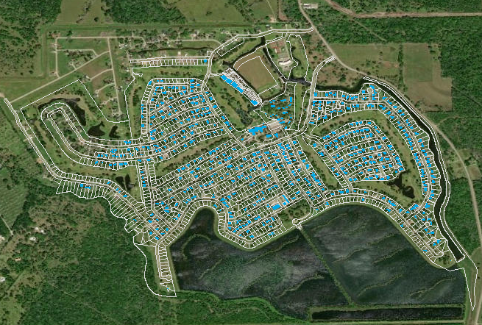
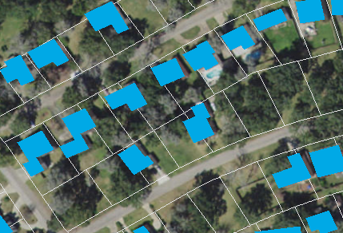

Slide 4

Solution
Create a script that can assign a parcel ID to each building footprint based on the largest area of the building footprint that falls within the parcel.
This BF would be assigned to this parcel
Not this one

Slide 5
Steps
1. Re-project shapefiles into same projection
2. Intersect parcels and building footprints
3. Recalculate area of building footprints
4. Calculate max area to find largest area
5. Subtract max area from original area to find largest area (=0)
6. Select all 0’s and create new shapefile from that selection that has building footprint ID and parcel ID

Slide 6
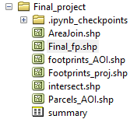
RESULTS

Slide 7
Problems? Of course
The script runs!!! Woo hoo
BUT, things I think need changing:
When joining the summary table to the intersected shpfile, the field names get funky
I have to reference the original shp files to see the PID and BID field names

